Slide 1



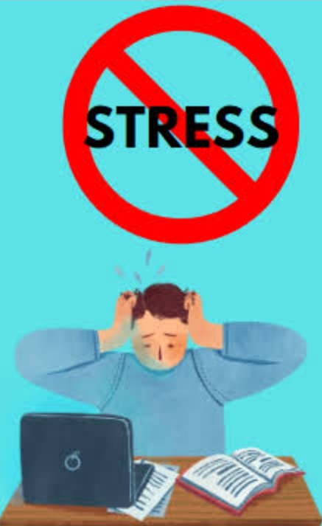
MOBILE FACILITATION TEAM
Topic: Management of Stress at Workplace
Sub-topic: WPS Identification and Management

Slide 2

MOBILE FACILITATION TEAM
Focus Area:
Workplace Stress Management
Evaristus P. Makota, MScNE, BScNE
Head of Research and Training Unit; M&E Champion-Njombe RRH

Slide 3

MOBILE FACILITATION TEAM
Presentation Outline
1. Definition of Workplace Stress (WPS)
2. Causes of WPS
3. WPS Warning Signs
4. Effects of WPS
5. Management of WPS
WPS Assessment Tools
Tips for WPS management
Self-WPS Assessment
6. Conclusion and way forwards
7. Welcome note for Q & A sessions

Slide 4
1.0. Definition of WPS
MOBILE FACILITATION TEAM

Slide 5
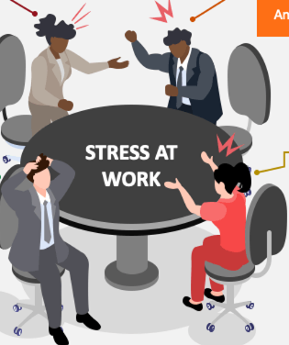
WPS Definition
Stress:Stress is defined as the body’s physiological and psychological response to internal or external demands that challenge an individual's ability to cope (Lazarus & Folkman, 1984). It can manifest in various forms, from short-term acute stress to long-lasting chronic stress, and can affect both mental and physical well-being.
Workplace Stress: Workplace stress is the harmful physical and emotional responses that occur when the demands of the job exceed the worker's ability to cope with them, leading to a mismatch between the individual's resources and the work environment (Cooper, Dewe, & O'Driscoll, 2001).
Stressed Participant in Meeting
MOBILE FACILITATION TEAM

Slide 6
2.0. Types of WPS
MOBILE FACILITATION TEAM

Slide 7
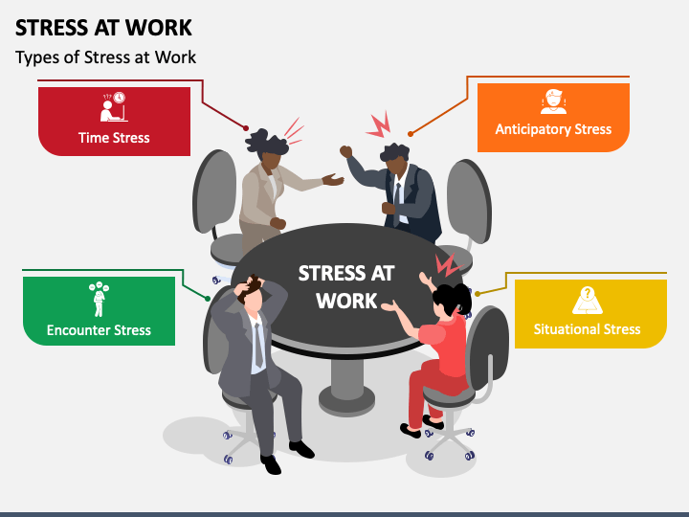
Types of Workplace Stress

Slide 8
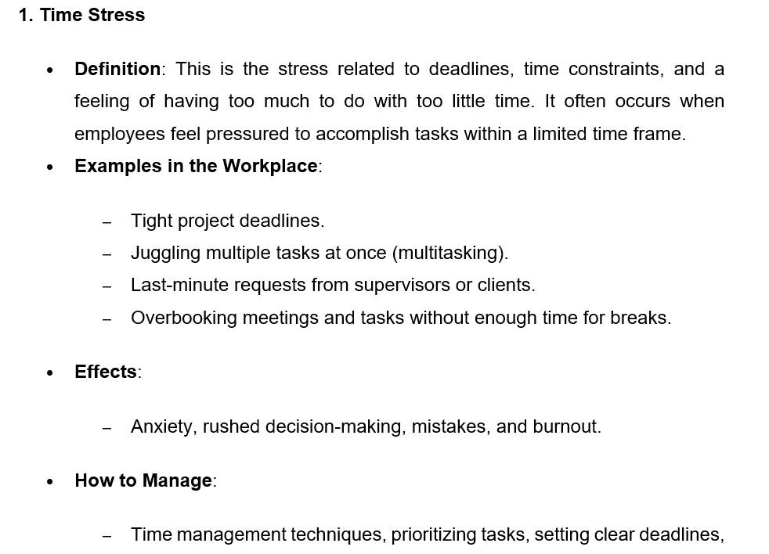
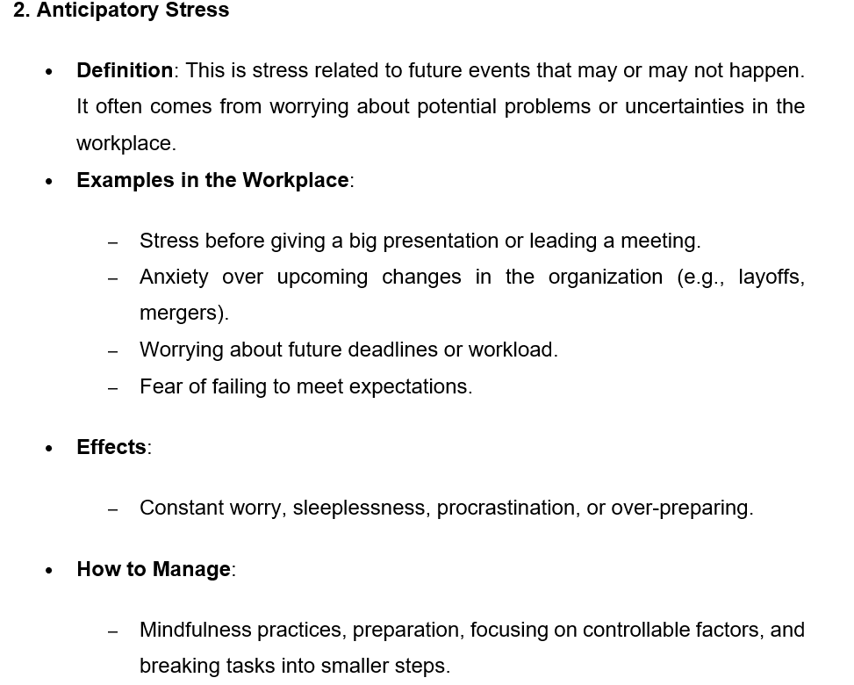

Slide 9
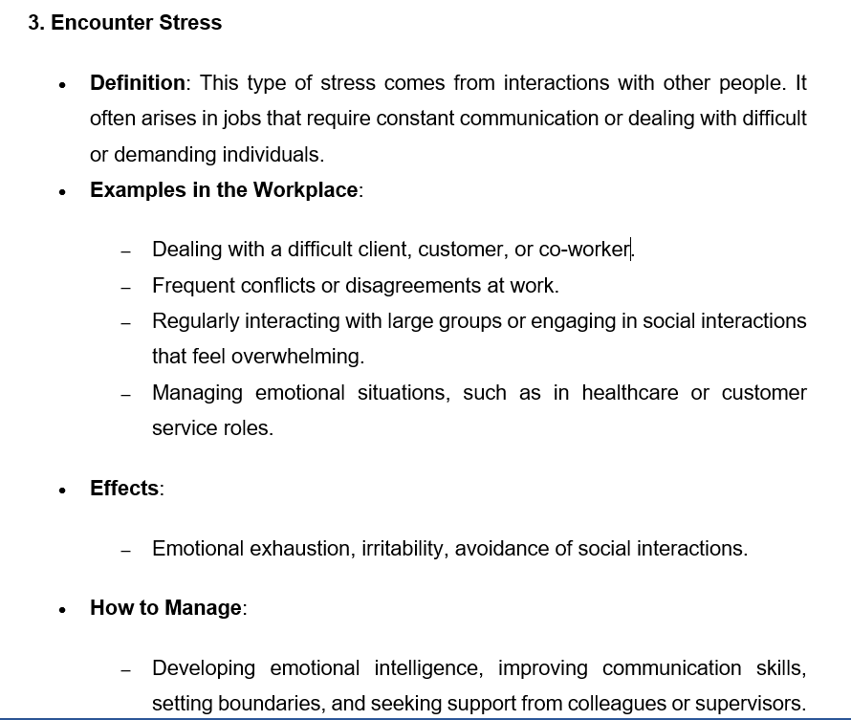
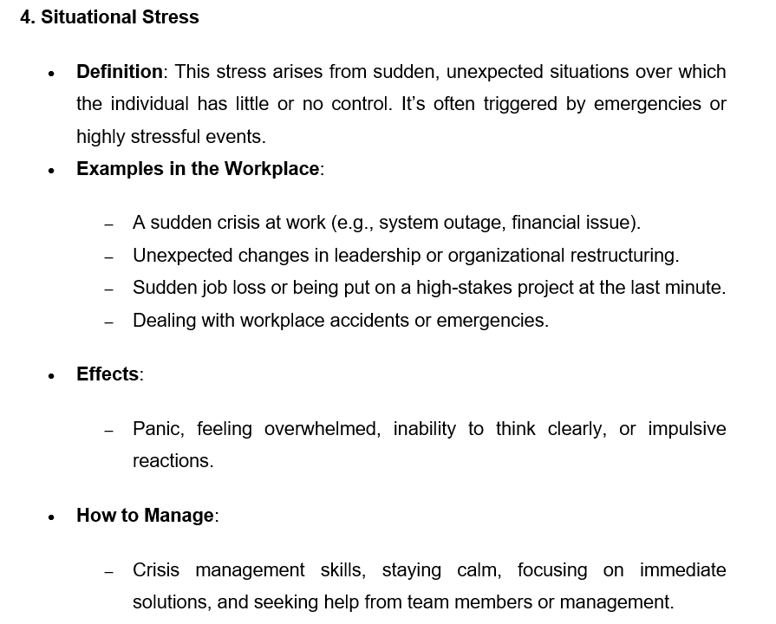

Slide 10
2.0. Causes of WPS
MOBILE FACILITATION TEAM

Slide 11
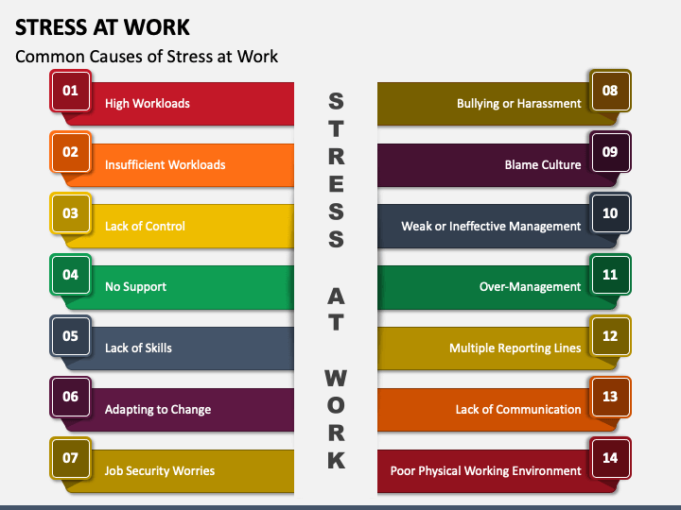

Slide 12
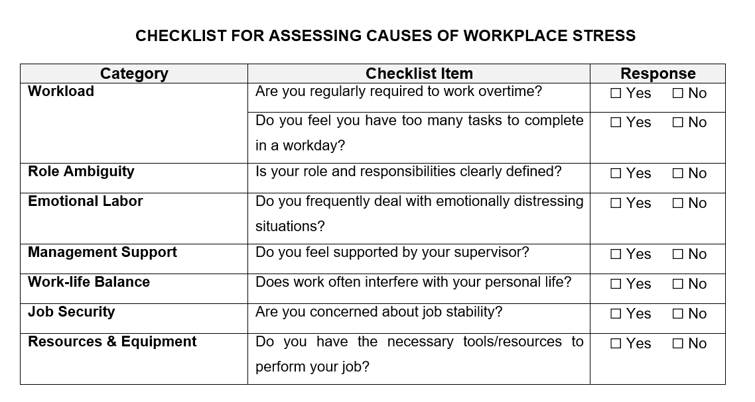

Slide 13
3.0. WPS Warning Signs
MOBILE FACILITATION TEAM

Slide 14
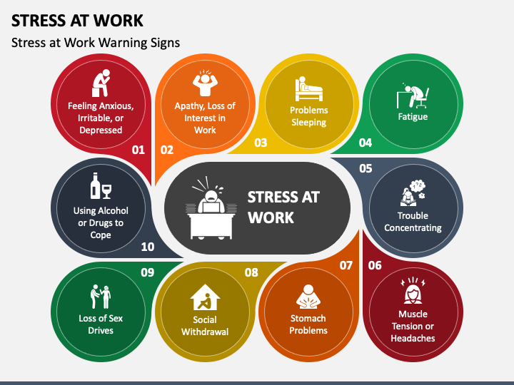

Slide 15
3.0. Effects of WPS-Burnouts
MOBILE FACILITATION TEAM

Slide 16
Effects of WPS: Burnouts (Prolonged WPS)
Burnout is a state of emotional, physical, and mental exhaustion caused by excessive and prolonged stress. It occurs when someone feels overwhelmed, emotionally drained, and unable to meet constant demands. Burnout can significantly affect both an individual’s well-being and their performance at work.
Key Aspects of Burnout
1. Emotional Exhaustion:
  Feeling completely drained and fatigued, unable to cope with stressors.
  Lack of energy to do even routine tasks.
  Feeling overwhelmed by work or responsibilities.
2. Cynicism or Detachment:
  Developing a negative or indifferent attitude toward work or colleagues.
  Feeling disconnected from the workplace or clients.
  Losing enthusiasm or passion for your job.
3. Reduced Performance or Accomplishment:
  Experiencing a decline in productivity and performance.
  Feeling ineffective or doubting your own abilities.
  Procrastination and loss of satisfaction in accomplishments.
MOBILE FACILITATION TEAM

Slide 17
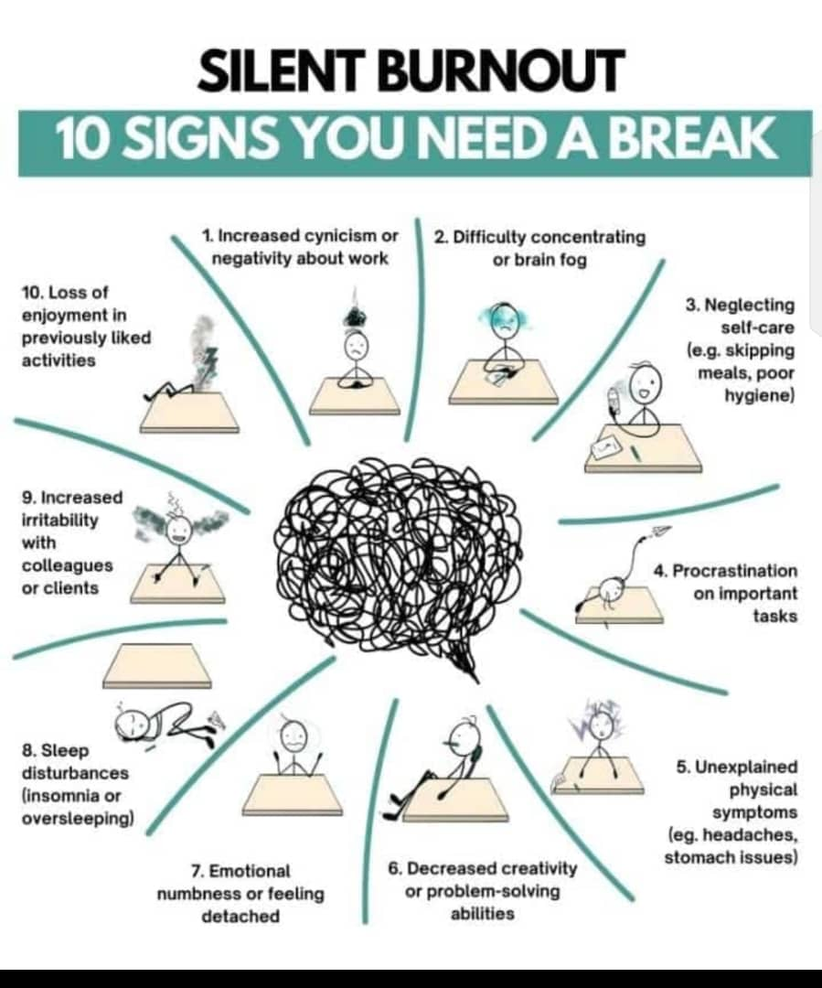
Signs of Burnouts

Slide 18
4.0. Management of WPS
MOBILE FACILITATION TEAM

Slide 19
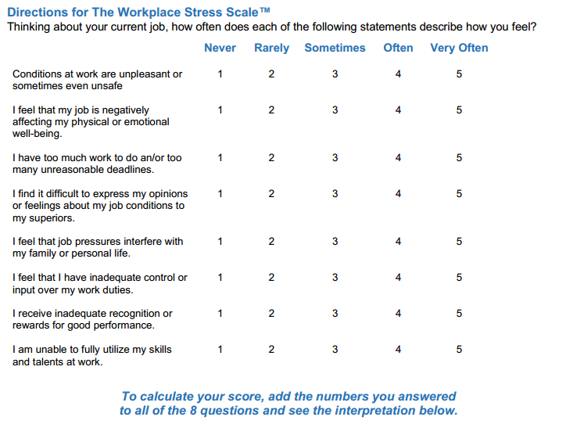
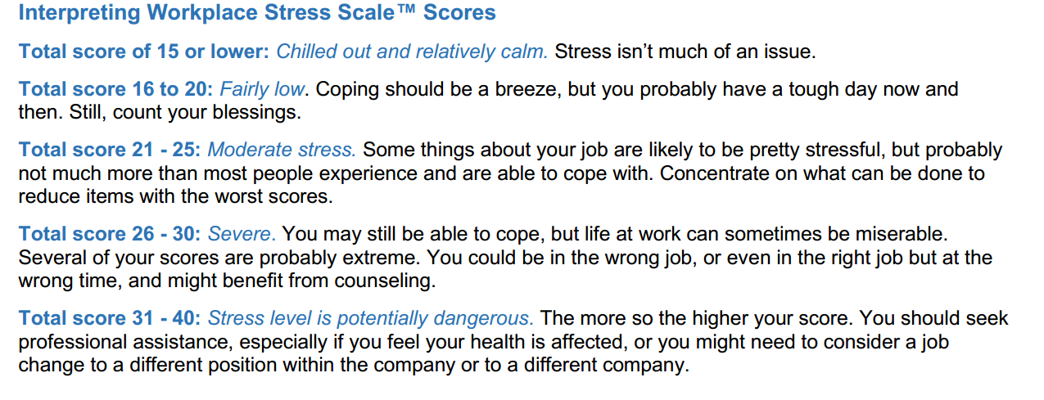
Workplace Stress Scale (America Institute of Stress)

Slide 20
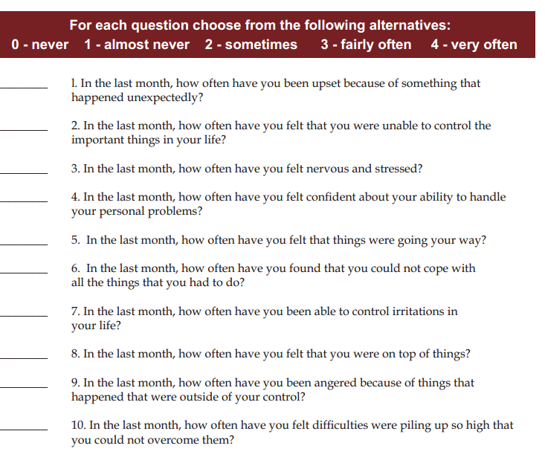
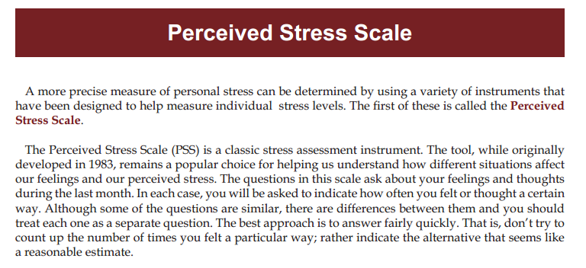
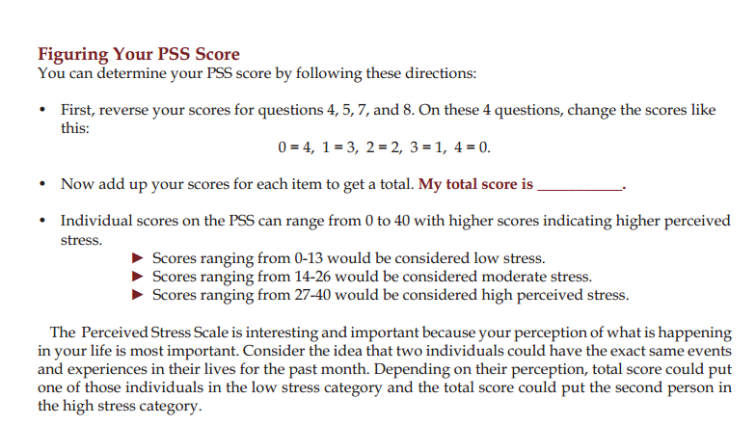
Perceived Stress Scale (Coheren)

Slide 21
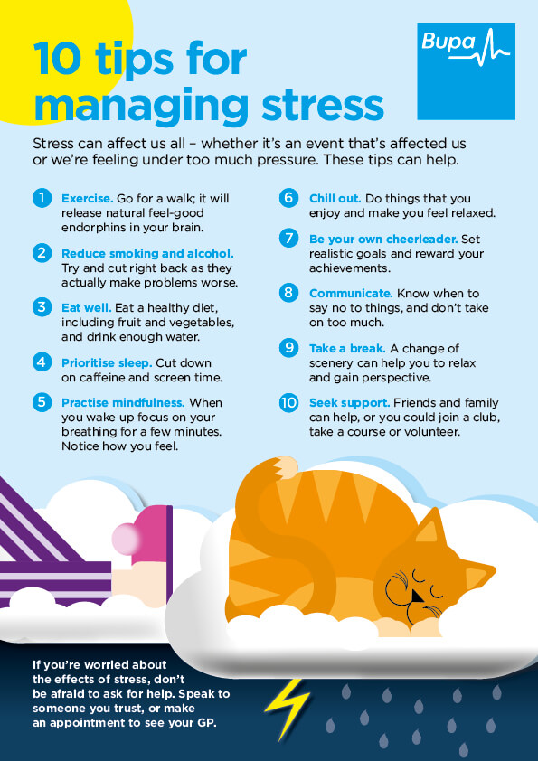
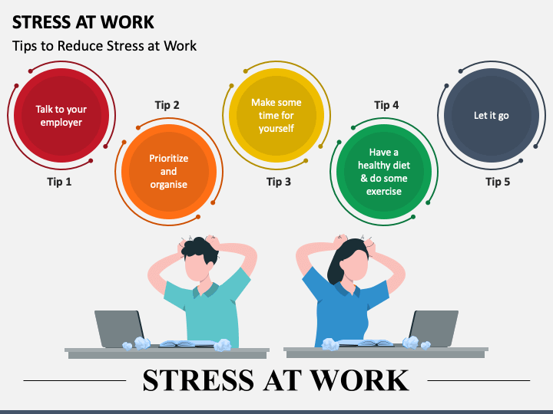
WPS Management Tips

Slide 22
Preventing and Managing Burnout/Workplace Stress:
1. Time Management
  Prioritize tasks and set realistic deadlines.
  Delegate when possible and avoid taking on too much.
2. Work-Life Balance
  Set boundaries between work and personal life, and take regular breaks.
  Engage in hobbies and activities that bring relaxation and enjoyment.
3. Self-Care
  Practice mindfulness, meditation, or relaxation techniques to manage stress.
  Exercise regularly, eat a balanced diet, and ensure you get enough sleep.
4. Seek Support
  Talk to colleagues, supervisors, or HR about workload and stressors.
  Consider speaking to a counsellor or therapist for professional guidance.
5. Create a Supportive Work Environment
  Encourage open communication and collaboration in the workplace.
  Ensure employees have the resources and support they need to succeed.

Slide 23
Consequences of Untreated Burnout/Workplace Stress
Mental Health Issues: Burnout can lead to anxiety, depression, and other mental health problems if not addressed.
2. Physical Health Problems: Prolonged stress and burnout may increase the risk of cardiovascular diseases, weakened immunity, and other health issues.
3. Job Performance: Burnout can lead to decreased productivity, higher absenteeism, and even job turnover.

Slide 24
Activity: WPS Self-Assessment
Perform WPS Self-Assessment to identify your status
Score, Calculate, and grade your WPS Status (Level)

Slide 25
Workplace Stress Scale (America Institute of Stress)

Slide 26
5.0. Conclusion and way forward
5.1. Conclusion: In conclusion, workplace stress is a multifaceted issue that affects employees at all levels of an organization. Identifying the sources of stress—whether it be time pressures, interpersonal conflicts, or uncertainty about the future—is the first step toward managing it effectively. By fostering a supportive work environment, encouraging open communication, and implementing stress management strategies, organizations can mitigate the negative impact of stress. Prioritizing employee well-being not only enhances productivity but also promotes a healthier, more resilient workforce
MOBILE FACILITATION TEAM

Slide 27
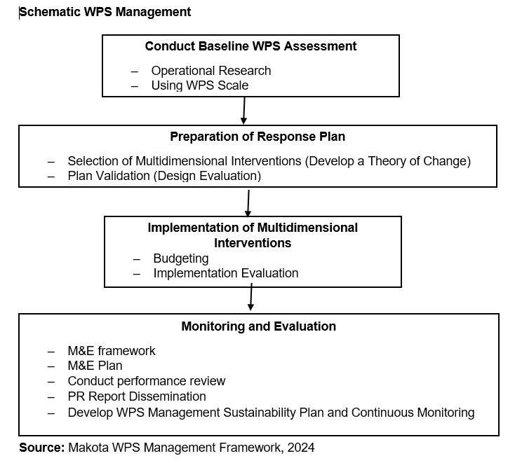
5.2. Way forward: Makota WPS Management Framework
MOBILE FACILITATION TEAM

Slide 28
M&E Framework for WPS Management
Objectives | Indicators | Definition | Targets | Data Source | Frequency | Assumption
M&E Plan Format for WPS Management
Introduction (Background and Objectives)
M&E Framework
Data Collection Methods and Tools
Data Analysis Plan
Reporting and Dissemination
Roles and Responsibilities of Key Stakeholders
Evaluation Plan
Budget for M&E Plan
MOBILE FACILITATION TEAM

Slide 29
6.0. Welcome note for Q & A Session
Is there WPS at your workplace and how big the problem is..............?
WPS Assessment
Diagnosis, prioritize and response plan development
Are there any set intervention program to address Stress and burnout in your workplace......?
Evidence based intervention; Opportunity for Innovation and Development
Share with us your set intervention
What is your WPS status?...No stress, Moderate stress or Severe Stress?
Perform self- WPS Assessment and set strategies
What are you doing to address Work-Life Balance?
MOBILE FACILITATION TEAM

Slide 30
References
Cohen, S., Kamarck, T., & Mermelstein, R. (1983). A global measure of perceived stress. Journal of Health and Social Behavior, 24(4), 385-396.
Cooper, C. L., Dewe, P. J., & O'Driscoll, M. P. (2001). Organizational stress: A review and critique of theory, research, and applications. SAGE Publications
Lazarus, R. S., & Folkman, S. (1984). Stress, appraisal, and coping. Springer Publishing CompanyCross. (1981).
Michie, S. (2002). Causes and management of stress at work. Occupational and Environmental Medicine, 59(1), 67-72.
Quick, J. C., & Henderson, D. F. (2016). Occupational Stress: Preventing Suffering, Enhancing Wellbeing. International Journal of Environmental Research and Public Health, 13(5), 459.
MOBILE FACILITATION TEAM

Slide 31
Thank You!
MOBILE FACILITATION TEAM

